Slide 1
Student Union Application
Team : UIX
Mohit Rangholiya(215410048)
Adekola Oluwatade Job(215383256)

Slide 2
Objective
To develop a fully responsive and functional web application named student union application using cloud services.
Student Union is a Web application which will be mobile friendly and compatible with all the devices.
Students can join the Union by registering student details
Member students can have different promotions/discounts from collaborated companies.
Various Events can be registered with limited number of participants

Slide 3
S/W & H/W Specifications
Designing Tools & Technologies
- HTML5, CSS, JS
- Sublime Text3
- Testing Emulators
- Different Web-Browsers
Implementation Tools & Technologies
- PHP, JSON, MySQL
- FileZilla v3.21.1
- Navicat for MySQL v11.2.11
- HP-LoadRunner v12.53.0

Slide 4
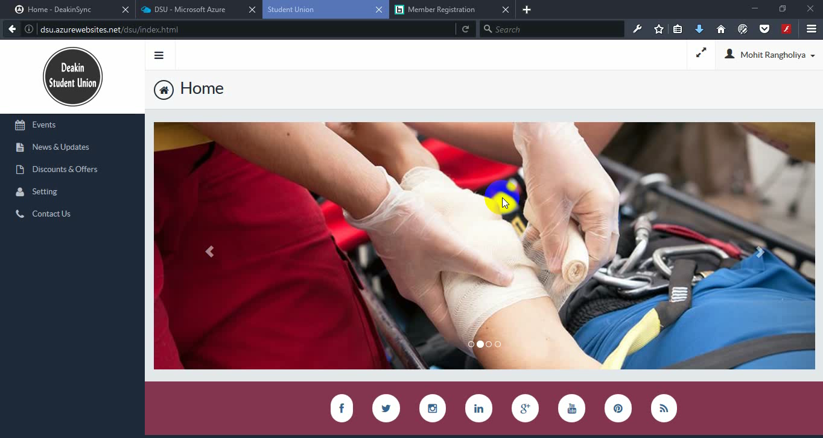
Design

Slide 5
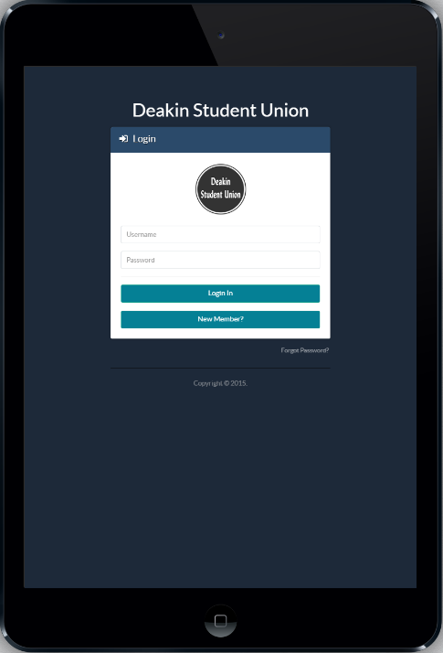
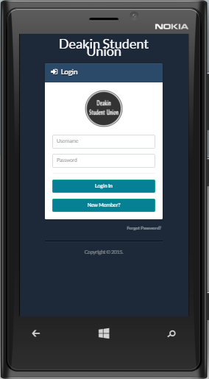
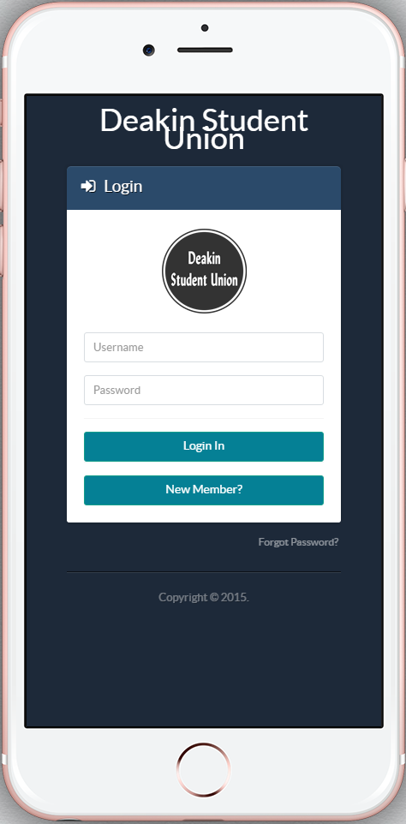
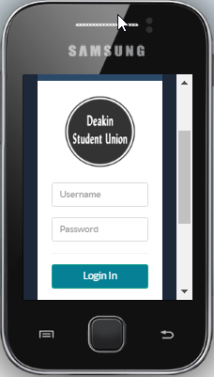
Design

Slide 6
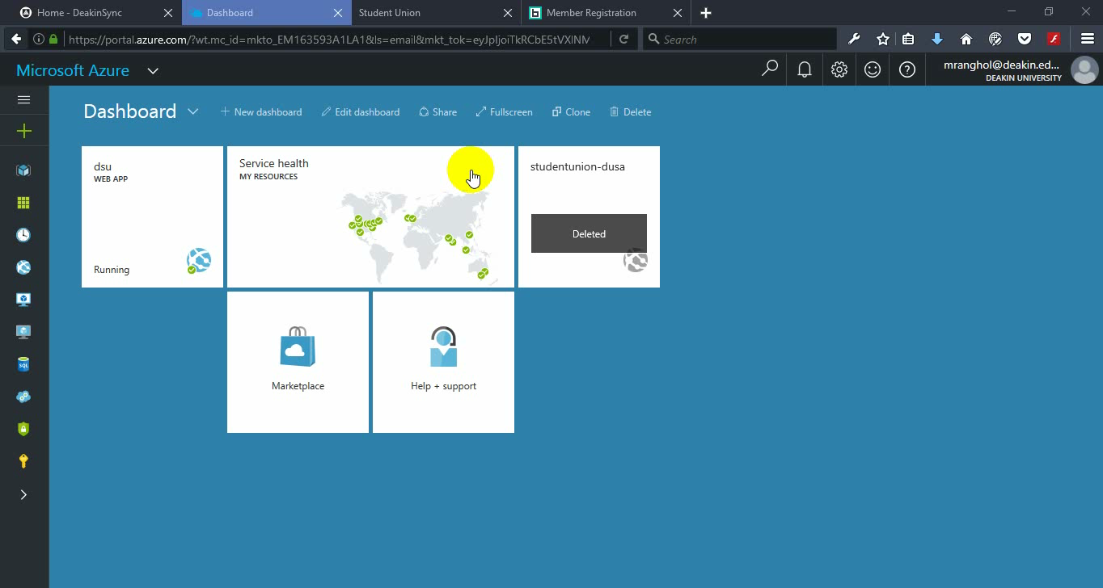
Implementation

Slide 7
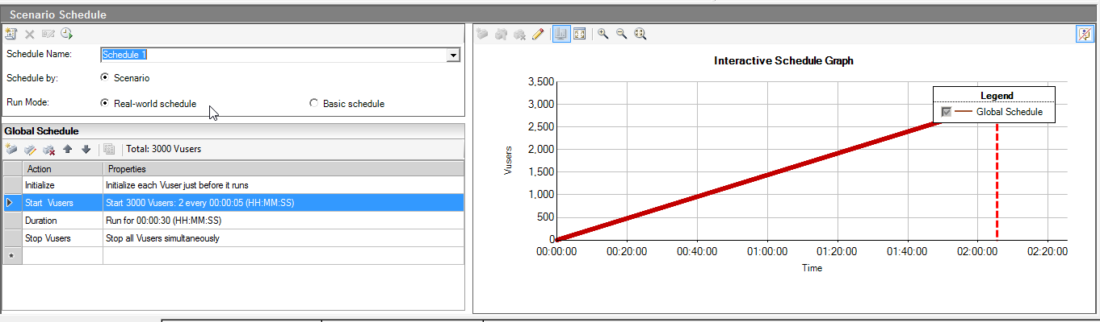
Performance Testing
HP LoadRunner Controller showing a 3000 Virtual user to be loaded on the web application

Slide 8
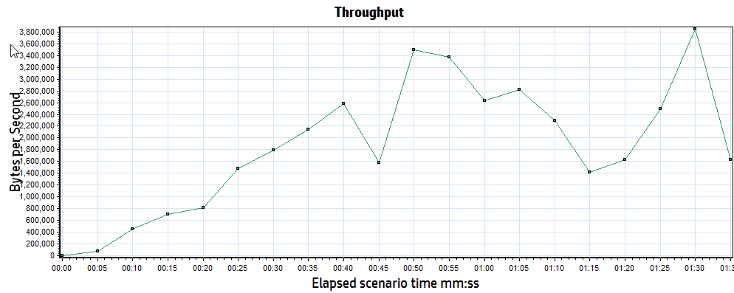
Performance Testing Cont’d
Throughput showing the amount of load the web application under test can take at any given time

Slide 9
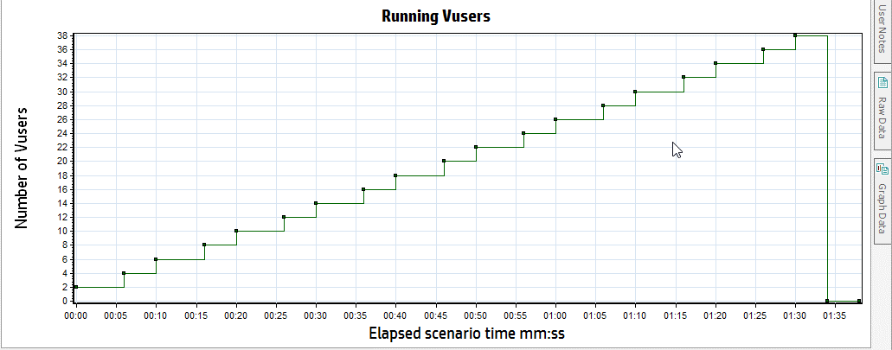
Performance Testing Cont’d
The graph representing the number of virtual user, the time taken to complete transactions before increasing the load on the app.

Slide 10
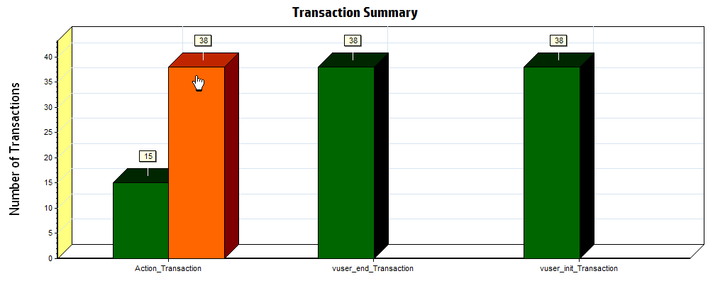
Performance Testing Cont’d
The chart shows the total number of successful transactions, number of stops and gives an overview of the summary of the test performed.

Slide 11
Testing
http://dsu1.azurewebsites.net/index.php

Slide 12
Thank You

